Slide 1
CSE 2451 File I/O
Zichen Zhang

Slide 2
Overview
File in Unix/Linux
stream
Standard input stream
Standard output stream
File stream
Common functions
fopen
Fclose
Positioning
fscanf/scanf
fprintf/printf
fgets/gets
fputs/puts
File operations
remove
rename

Slide 3
In Unix, everything is a file
User input and output are files
Hard drives and USB drives are files
/dev/sd*
system statistics are files
/proc/meminfo
/proc/cpuinfo
Mouse and keyboard are files
/dev/input/event*
Random number generators are files
/dev/random
/dev/urandom

Slide 4
Binary Files vs Text Files
Binary files are designed to be read only by programs (bit sequence)
Images (JPG, PNG, GIF), videos (MP4, MKV), music (MP3, FLAC), compressed files (zip, 7z, gz), compiled executables (.exe, .o, .jar), etc.
Can contain any kind of data
Text files are designed to be human readable, but can be used by programs too
txt, markdown, RST
XML, HTML, CSV, JSON
.c, .cpp, .java, .py
Should only contain human readable characters (a-z, punctuation, numbers, etc.)
Unix and Linux make no distinction between text and binary files
Windows does

Slide 5
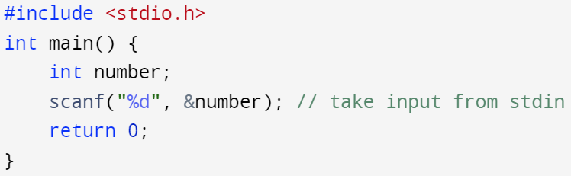
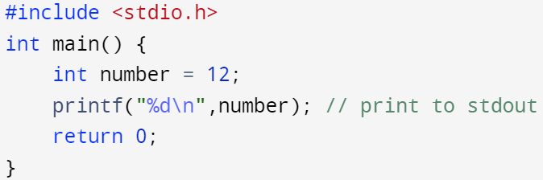
Interaction with files using file stream
Stream is a sequence of characters with functions to take characters out of one end and put characters into the other end
C interacts with files (including user input/output files) through file streams.
The standard input (stdin), standard output (stdout) streams, and standard error (stderr) stream are pre-opened streams in #include <stdio.h>
Standard input stream: stdin
Standard output stream: stdout
scanf() is internally connected to stdin
program
standard Input stream
Input device (file)
printf() is internally connected to stdout
program
standard output stream
display device (file)

Slide 6
Open a file as file stream for read/write
Open a file as file stream for subsequent interactions
FILE * fopen(const char *filename, const char *mode);
Close the file stream after the interactions are completed
int fclose(FILE * stream);
program
file stream
file
mode controls the direction of interaction

Slide 7
FILE * fopen (const char *filename, const char *mode)
Current working directory is where the executable is run, not where the executable is stored.
# run prog in its storing directory
./prog
# run prog in the parent directory of its storing directory
src_dir/prog
Opens a file as file stream
FILE * is called a file handle (pointer)
Returns a pointer to the file stream
Returns NULL if fopen fails (file doesn’t exist)
filename can be:
Just a name: "myfile.txt"
Checks the current working directory
Relative path: "somedir/myfileA.txt" or "../myfileB.txt"
The file named "myfileA.txt" inside directory "somedir" inside current directory
The file named “myfileB.txt“ is one level outside of the current directory
Absolute path: "/dev/random.txt"
The file named "random.txt" inside directory "dev", which is at the top level
Close the file stream with fclose(FILE *) after usage

Slide 8
FILE * fopen (const char *filename, const char *mode)
mode is used to choose what you will do with the file
mode | read | write | create new file | truncate | pointer loc
r | 1 | 0 | 0 | 0 | 1st character
w | 0 | 1 | 1 | 1 | 1st character
a | 0 | 1 | 1 | 0 | last character
r+ | 1 | 1 | 0 | 0 | 1st character
w+ | 1 | 1 | 1 | 1 | 1st character
a+ | 1 | 1 | 1 | 0 | last character
create new file:
1: create new file if it doesn’t exist
0: return NULL
truncate:
1: if the file already exists, truncate its length to 0
0: if the file already exists, its content will be preserved
Pointer loc: returned pointer location if fopen() is successful, otherwise return NULL
add b to existing modes for binary files (e.g., rb, wb, ab, etc.)

Slide 9
int fclose(FILE * stream);
Close a file stream opened with fopen()
Returns 0 if succeeded
Returns EOF if failed
EOF: keyword for end-of-file, defined by #define macro
How to type EOF as user input with keyboard
Linux: “Control + d”
Windows: “Control + z”
Potential issues if forgetting to use fclose() on file stream
If you forget to close a file handle after usage and try to open this file again later in your program, the 2nd fopen() may fail depending on the modes

Slide 10
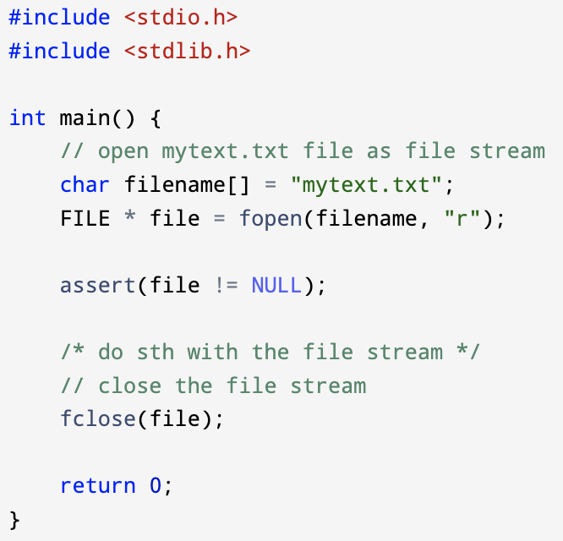
Pair fopen() and fclose() – example
<assert.h>
Use double quote “r”, for mode, this enforce the mode to be a constant string instead of a constant character ‘r’ (avoid implicit integer promotion)
assert(expression):
#include <assert.h>, if expression evaluates to 0 (false), then the expression, the source code file name, and the line number of assert() are sent to stderr, then abort() is called to stop the program execution
Notes:
Exit vs abort vs assert
https://www.geeksforgeeks.org/understanding-exit-abort-and-assert/

Slide 11
Positioning
As you write or read a file, you move forward, i.e., the file handle is moving towards the end of file
FILE *file = fopen("hopper.txt", "r+")
Grace Hopper was a pioneer of computer programming.
char arr[13];
fgets(arr, 13, file);
Grace Hopper was a pioneer of computer programming.
fgets() is a function reading a string from file stream, we will cover it in the later slides

Slide 12
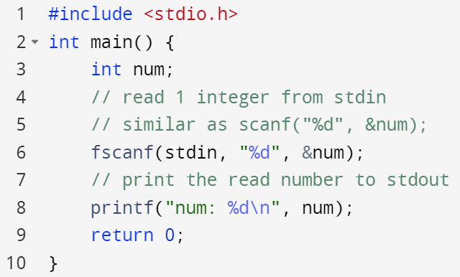
int fscanf(FILE *stream, const char *format, …)
fscanf() is similar to scanf() but not limited to take input from stdin
scanf(“%d”, &num); is the same as fscanf(stdin, ”%d”, &num);
Read numbers/characters/strings from stream
format string: specify the format of the input:
”%d” → 1 integer
“%d, %f” → 1 integer followed by a comma and a whitespace, then followed by a float
…: variable length input arguments: fscanf(file, “%d %d”, &num1, &num2);
return (1) the number of input items successfully assigned, or (2) EOF if input failure occurs before 1st receiving argument was assigned
Your format string “%d” and your input needs to match with each other for a successful extraction
Extracting one integer “%d” from stdin stream and save it to variable num

Slide 13
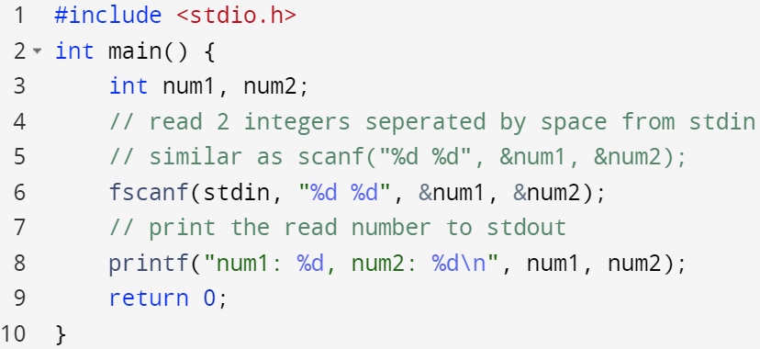
int fscanf(FILE *stream, const char *format, …)
fscanf() is similar to scanf() but not limited to take input from stdin
scanf(“%d”, &num); is the same as fscanf(stdin, ”%d”, &num);
Read numbers/characters/strings from stream
format string: specify the format of the input:
”%d” → 1 integer
“%d, %f” → 1 integer followed by a comma and a whitespace, then followed by a float
…: variable length input arguments: fscanf(file, “%d %d”, &num1, &num2);
return (1) the number of input items successfully assigned, or (2) EOF if input failure occurs before 1st receiving argument was assigned
Extracting 2 integers “%d %d” and save it to variables num1 and num2 respectively

Slide 14
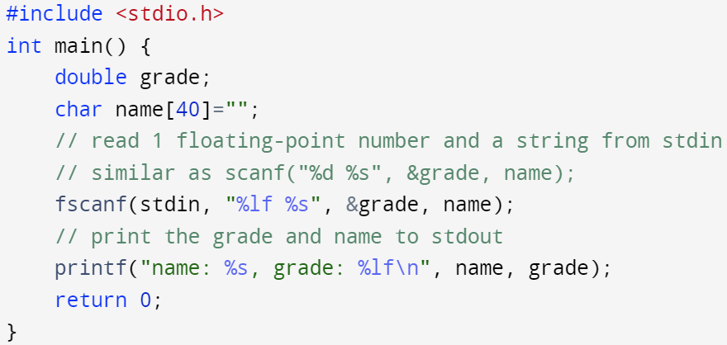
int fscanf(FILE *stream, const char *format, …)
fscanf() is similar to scanf() but not limited to take input from stdin
scanf(“%d”, &num); is the same as fscanf(stdin, ”%d”, &num);
Read numbers/characters/strings from stream
format string: specify the format of the input:
”%d” → 1 integer
“%d, %f” → 1 integer followed by a comma and a whitespace, then followed by a float
…: variable length input arguments: fscanf(file, “%d %d”, &num1, &num2);
return (1) the number of input items successfully assigned, or (2) EOF if input failure occurs before 1st receiving argument was assigned
You can specify different format to interpret the sequence of characters read from stdin and save them to the respective types variables

Slide 15
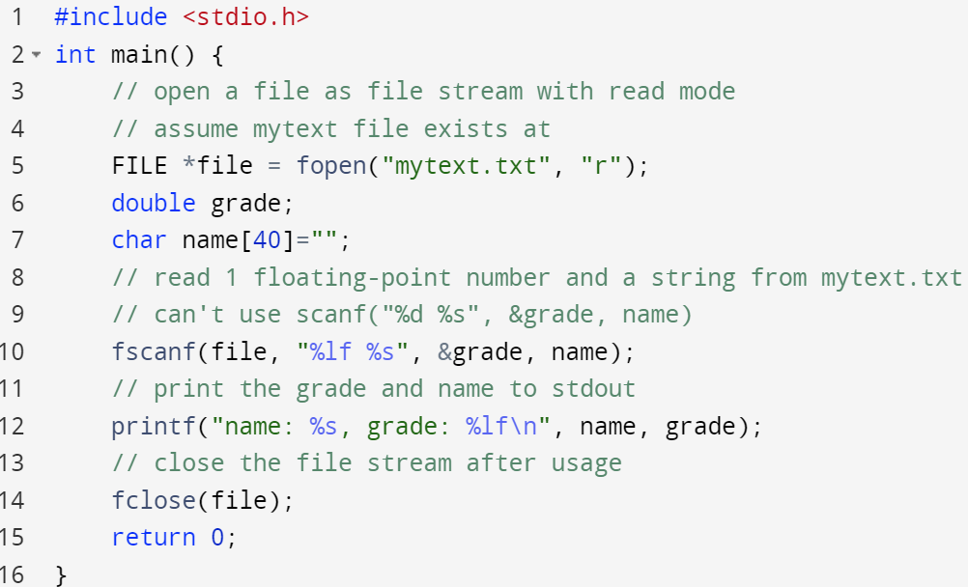
int fscanf(FILE *stream, const char *format, …)
fscanf() is similar to scanf() but not limited to take input from stdin
scanf(“%d”, &num); is the same as fscanf(stdin, ”%d”, &num);
Read numbers/characters/strings from stream
format string: specify the format of the input:
”%d” → 1 integer
“%d, %f” → 1 integer followed by a comma and a whitespace, then followed by a float
…: variable length input arguments: fscanf(file, “%d %d”, &num1, &num2);
return (1) the number of input items successfully assigned, or (2) EOF if input failure occurs before 1st receiving argument was assigned
You can replace stdin with other file streams opened with fopen()
Remember to close the file after usage
mytext.txt file
93.5 Tom

Slide 16
int fscanf(FILE *stream, const char *format, …)
If there are any spaces in format, it will look for some amount of whitespace (spaces, tabs, new lines)
If your input looks like “10 52 32” then you can use “%d %d %d” to read it, since the extra whitespaces will be skipped by fscanf() function
This rule does NOT apply to “%c” format specifier as whilespace character is also considered as a character to extract
Whitespace characters are not included in string format specifier “%s”
If there are any characters in format other than %d, %f etc., it will read and skip these characters
If your input looks like "10,52,32" then you can use "%d,%d,%d" to read it
If those characters (commas in the above example) don't exist, then the read will fail

Slide 17
format of scanf/fscanf
Everything in the stream is initially just plain characters, format is used to parse these characters into different types of data
scanf(const char *format, …)
scanf(“%d”, &num); // extract a decimal integer, save to num
scanf(“%s”, str); // extract a string, save to str
scanf(“%d, %lf”, &cnt, &price); // extract a decimal and a floating-point number, save them to cnt and price, respectively
fscanf(FILE *stream, const char *format, …)
fscanf(fp, “%d”, &num);
fscanf(fp, “%s”, str);
fscanf(fp, “%d, %lf”, &cnt, &price);

Slide 18
format of scanf/fscanf – example
// Read an integer in decimal format (123456789)
fscanf(file, "%d", &num);
// Read an integer in any format (123456789, or 0x0A2F36)
fscanf(file, "%i", &num);
// Read a floating-point number
fscanf(file, "%f", &num);
// Read a long integer in decimal format
fscanf(file, "%ld", &num);
// Read a “long” float (double)
fscanf(file, "%lf", &num);

Slide 19
format of scanf/fscanf – example
// Keep reading while next character is 'a', 'b', or 'c'
fscanf(file, "%[abc]", str);
// Keep reading while next character is a lowercase letter
fscanf(file, "%[a-z]", str);
// Keep reading while next character is NOT a lowercase letter
fscanf(file, "%[^a-z]", str);
// Keep reading while next character is NOT ','
fscanf(file, "%[^,]", str);
// Only read up to 19 characters (save 1 space for null terminator '\0')
char my_arr[20]=“”;
fscanf(file, "%19s", my_arr);
// Windows only, avoid!
fscanf_s(file, "%s", my_arr, 20);

Slide 20
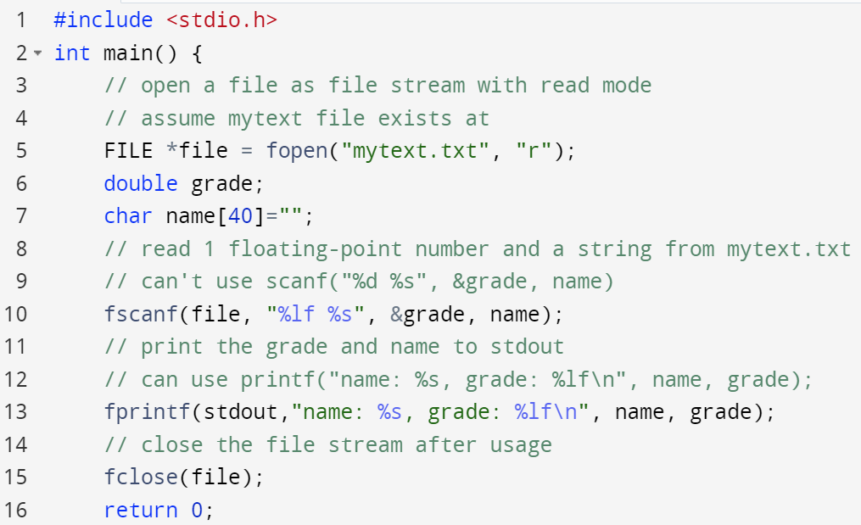
int fprintf(FILE *stream, const char * format, …);
fprintf() is similar to printf but not limited to stdout
printf("%d", num); is the same as fprintf(stdout, "%d", num);
stream is either stdout or a file stream
format is the C string that contains the text to be written to the stream. It can optionally contain embedded format tags (%d, %c, %s, %f) that are replaced by the values specified in subsequent additional arguments (…) and formatted as requested
return: If successful, the total number of characters written is returned otherwise, a negative number is returned
You can replace printf() with fprintf() and specify the file stream to be stdout, everything else will stay the same as printf() function.
You can also replace stdout with some other file stream opened with the write or append mode to write to the associated files

Slide 21
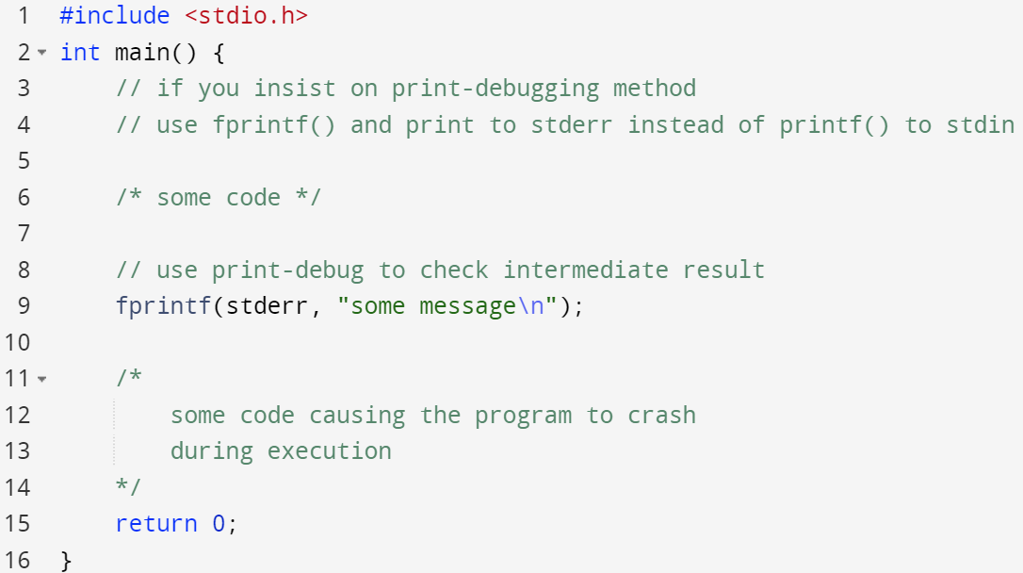
int fprintf(FILE *stream, const char * format, …);
fprintf() is similar to printf but not limited to stdout
printf("%d", num); is the same as fprintf(stdout, "%d", num);
stream is either stdout or a file stream
format is the C string that contains the text to be written to the stream. It can optionally contain embedded format tags (%d, %c, %s, %f) that are replaced by the values specified in subsequent additional arguments (…) and formatted as requested
return: If successful, the total number of characters written is returned otherwise, a negative number is returned
Use fprintf() to print to stderr instead of stdout if you want to debug your source code in a print-debugging fashion
print to stdout will move the “to be printed content” to a buffer in heap segment first
Print to stderr will immediately print out the content

Slide 22
format of printf/fprintf – example
// Print an integer (%i also works, but does the same thing)
fprintf(file, "%d", num);
// Print a long integer in decimal format
fprintf(file, "%ld", num);
// Same as fscanf for float and double too
// Pad to 5 characters
fprintf(file, "%5d\n%5d\n", 1234, 12345);
// Print only 3 digits after the point
fprintf(file, "%.3f", 123.456789);
Prints:
1234
12345
Prints:
123.456

Slide 23
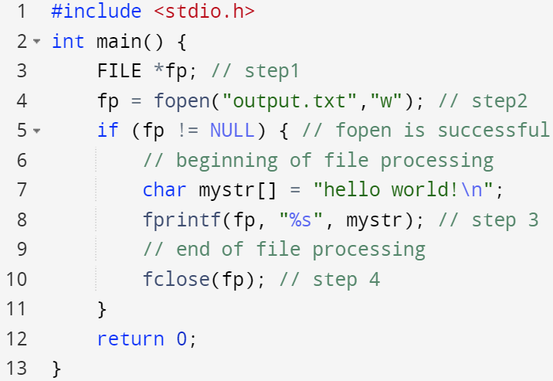
Steps for processing a file - summary
Declare a FILE pointer
Open a file using fopen() function
Process the file using proper functions
Close the file using fclose() function

Slide 24
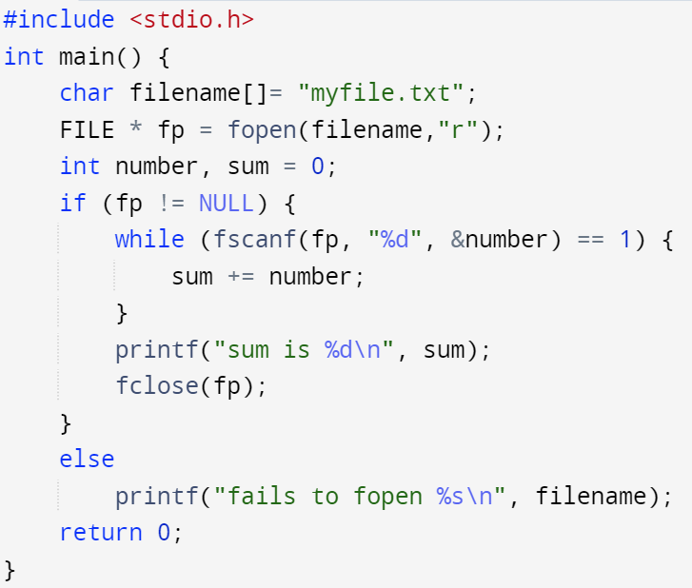
Reading file with fscanf - example
Input file:
1 2 3 4
5 6 7 8
Output:
sum is 36

Slide 25
Reading file with fscanf - example
Input file:
1 2 3 4
5 h 7 8
Output:
15
fscanf returns number of successful match:
At h, fscanf will return 0, break out of the while loop
And h is stuck in the file stream, i.e., fp is still pointing to h

Slide 26
EOF test and error test
int feof ( FILE *stream);
Tests the end-of-file indicator for the stream
stream: the pointer to a FILE object (file handler)
return: a non-zero int value when End-Of-File of the stream is reached, otherwise return 0
int ferror ( FILE *stream);
Tests the error indicator for the stream
stream: the pointer to a FILE object (file handler)
return: a non-zero int value when the error indicator associated with the stream was set (e.g., mismatch between fopen mode and subsequent operations, open with “r” mode, but trying to write to the file)

Slide 27
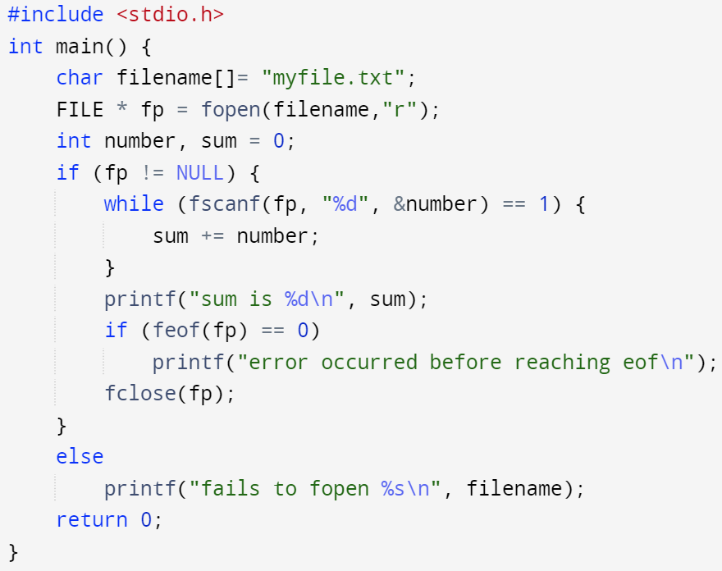
Reading file with fscanf + feof – example
Input file:
1 2 3 4
5 h 7 8
Output:
15
error occurred before reaching eof
Use feof() to check if we exit the while-loop without any error caused by mismatch between format & input data

Slide 28
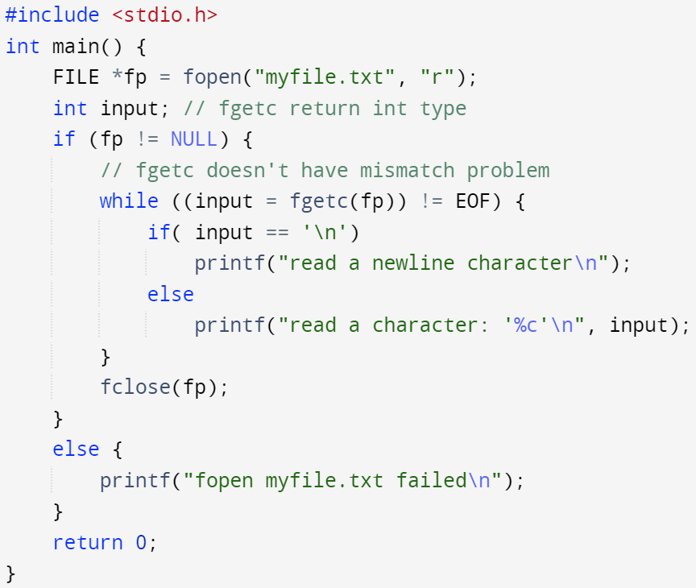
int fgetc (FILE *stream);
Read a single character from the file stream
Returns the character that was read, or EOF when reaching the end of the file
Input file:
Hello
!
Output:
read a character: ‘H’
read a character: ‘e’
read a character: ‘l’
read a character: ‘l’
read a character: ‘o’
read a newline character
read a character: ‘!’

Slide 29
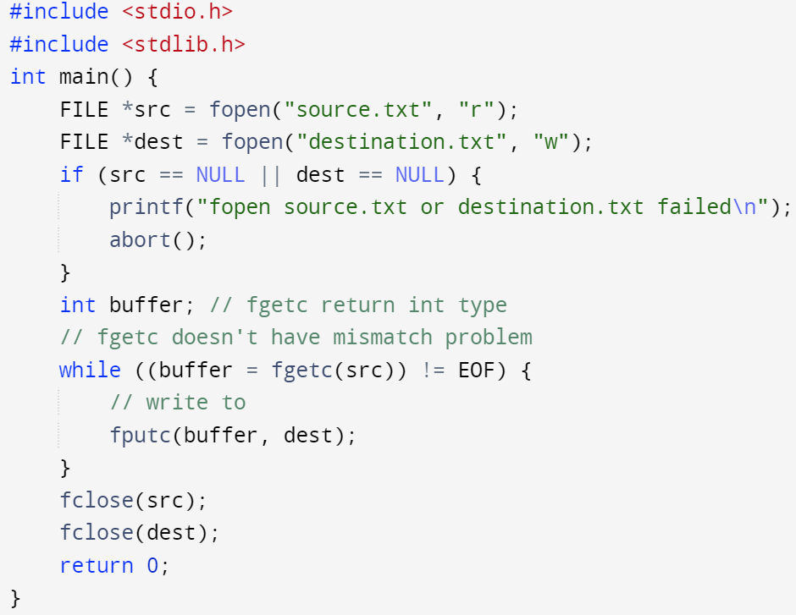
int fputc (int ch, FILE *stream);
Write a single character to the file stream
Returns the character that was written, or EOF if there was an error
Input file:
The src code file itself
Output:
A copy of the source code file

Slide 30
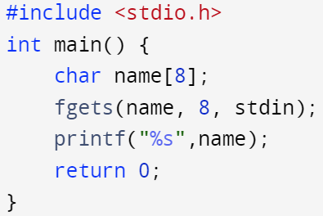
char *fgets (char *str, int num, FILE *stream);
Reads a string from stream into str
It will read until either:
It reads num-1 characters (last char is set to ‘\0’)
It encounters a newline ('\n')
It reaches the end of the file (EOF)
If it fails to read, it will return NULL, otherwise str
If it reached EOF, str will remain unchanged, return NULL
If encounters a newline, the newline will be included in str
Different from char gets(char *str), gets() is more flexible/dangerous: No buffer protection, doesn’t include newline character in the storage
Input: coffee
Output: coffee
Input: chocolate
Output: chocola
Buffer protection, read at most 7 characters and leave 1 extra character for ‘\0’

Slide 31
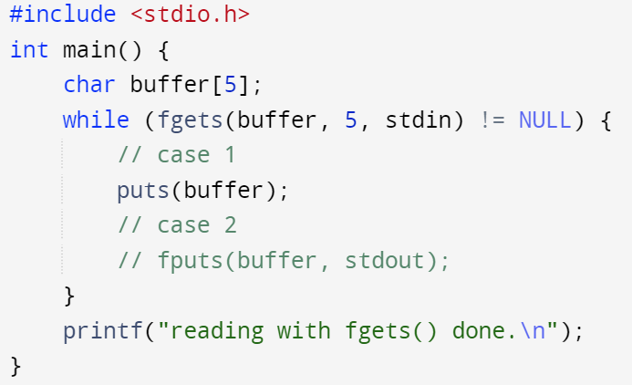
int fputs (const char *str, FILE *stream);
int puts(const char *str);
Writes the null-terminated string str to the output stream
If an error occurs, fputs returns EOF. Otherwise, fputs returns a non-negative integer
puts() writes the string str and appends ‘\n’ character to the stdout stream
stdin:
123
abc
stdout:
123
abc
reading with fgets() done.

Slide 32
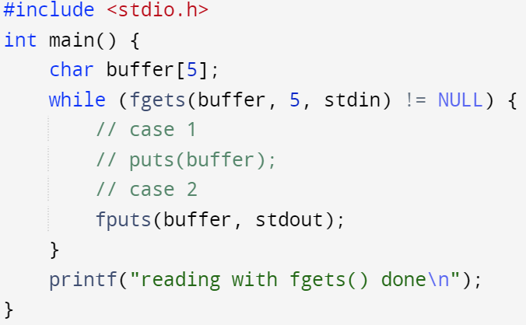
int fputs (const char *str, FILE *stream);
int puts(const char *str);
Writes the null-terminated string str to the output stream
If an error occurs, fputs returns EOF. Otherwise, fputs returns a non-negative integer
fputs() writes the string str to the stdout stream without appending a ‘\n’ in the end
stdin:
123
abc
stdout:
123
abc
reading with fgets() done.

Slide 33
fgets/fputs and gets/puts
gets() pairs with puts()
Limited to standard streams
gets() will ignore ‘\n’ character in stdin
puts() will append additional ‘\n’ character to the string before write to stdout
fgets() pairs with fputs()
Not limited to standard streams, you can replace them with file streams
fgets() will include ‘\n’ character from the stream
fputs() will not append additional ‘\n’ character to the string before write to the stream

Slide 34
File Operations
int remove ( const char * filename );
Deletes the file
Return 0 if success, return -1 if an error occurred
int rename ( const char * oldname, const char * newname );
Renames the file
If newname is in a different directory, the file will be moved there
Return 0 if success, return -1 if an error occurred
Note that these accept the path of the file, NOT the file handle
The file handle must be closed before deleting or renaming the file

